Slide 1
DPDK Roadmap Features M Jay, Pravin Kantak, Walt Gilmore
December 5, 2014

Slide 2
Legal Disclaimer
INFORMATION IN THIS DOCUMENT IS PROVIDED IN CONNECTION WITH INTEL PRODUCTS. NO LICENSE, EXPRESS OR IMPLIED, BY ESTOPPEL OR OTHERWISE, TO ANY INTELLECTUAL PROPERTY RIGHTS IS GRANTED BY THIS DOCUMENT. EXCEPT AS PROVIDED IN INTEL'S TERMS AND CONDITIONS OF SALE FOR SUCH PRODUCTS, INTEL ASSUMES NO LIABILITY WHATSOEVER AND INTEL DISCLAIMS ANY EXPRESS OR IMPLIED WARRANTY, RELATING TO SALE AND/OR USE OF INTEL PRODUCTS INCLUDING LIABILITY OR WARRANTIES RELATING TO FITNESS FOR A PARTICULAR PURPOSE, MERCHANTABILITY, OR INFRINGEMENT OF ANY PATENT, COPYRIGHT OR OTHER INTELLECTUAL PROPERTY RIGHT. A "Mission Critical Application" is any application in which failure of the Intel Product could result, directly or indirectly, in personal injury or death. SHOULD YOU PURCHASE OR USE INTEL'S PRODUCTS FOR ANY SUCH MISSION CRITICAL APPLICATION, YOU SHALL INDEMNIFY AND HOLD INTEL AND ITS SUBSIDIARIES, SUBCONTRACTORS AND AFFILIATES, AND THE DIRECTORS, OFFICERS, AND EMPLOYEES OF EACH, HARMLESS AGAINST ALL CLAIMS COSTS, DAMAGES, AND EXPENSES AND REASONABLE ATTORNEYS' FEES ARISING OUT OF, DIRECTLY OR INDIRECTLY, ANY CLAIM OF PRODUCT LIABILITY, PERSONAL INJURY, OR DEATH ARISING IN ANY WAY OUT OF SUCH MISSION CRITICAL APPLICATION, WHETHER OR NOT INTEL OR ITS SUBCONTRACTOR WAS NEGLIGENT IN THE DESIGN, MANUFACTURE, OR WARNING OF THE INTEL PRODUCT OR ANY OF ITS PARTS. Intel may make changes to specifications and product descriptions at any time, without notice. Designers must not rely on the absence or characteristics of any features or instructions marked "reserved" or "undefined". Intel reserves these for future definition and shall have no responsibility whatsoever for conflicts or incompatibilities arising from future changes to them. The information here is subject to change without notice. Do not finalize a design with this information. The products described in this document may contain design defects or errors known as errata which may cause the product to deviate from published specifications. Current characterized errata are available on request. Contact your local Intel sales office or your distributor to obtain the latest specifications and before placing your product order. Copies of documents which have an order number and are referenced in this document, or other Intel literature, may be obtained by calling 1-800-548-4725, or go to: http://www.intel.com/design/literature.htm%20 Performance tests and ratings are measured using specific computer systems and/or components and reflect the approximate performance of Intel products as measured by those tests. Any difference in system hardware or software design or configuration may affect actual performance. Buyers should consult other sources of information to evaluate the performance of systems or components they are considering purchasing. For more information on performance tests and on the performance of Intel products, visit Intel Performance Benchmark Limitations All products, computer systems, dates and figures specified are preliminary based on current expectations, and are subject to change without notice. Celeron, Intel, Intel logo, Intel Core, Intel Inside, Intel Inside logo, Intel. Leap ahead., Intel. Leap ahead. logo, Intel NetBurst, Intel SpeedStep, Intel XScale, Itanium, Pentium, Pentium Inside, VTune, Xeon, and Xeon Inside are trademarks or registered trademarks of Intel Corporation or its subsidiaries in the United States and other countries. Intel® Active Management Technology requires the platform to have an Intel® AMT-enabled chipset, network hardware and software, as well as connection with a power source and a corporate network connection. With regard to notebooks, Intel AMT may not be available or certain capabilities may be limited over a host OS-based VPN or when connecting wirelessly, on battery power, sleeping, hibernating or powered off. For more information, see http://www.intel.com/technology/iamt. 64-bit computing on Intel architecture requires a computer system with a processor, chipset, BIOS, operating system, device drivers and applications enabled for Intel® 64 architecture. Performance will vary depending on your hardware and software configurations. Consult with your system vendor for more information. No computer system can provide absolute security under all conditions. Intel® Trusted Execution Technology is a security technology under development by Intel and requires for operation a computer system with Intel® Virtualization Technology, an Intel Trusted Execution Technology-enabled processor, chipset, BIOS, Authenticated Code Modules, and an Intel or other compatible measured virtual machine monitor. In addition, Intel Trusted Execution Technology requires the system to contain a TPMv1.2 as defined by the Trusted Computing Group and specific software for some uses. See http://www.intel.com/technology/security/ for more information. †Hyper-Threading Technology (HT Technology) requires a computer system with an Intel® Pentium® 4 Processor supporting HT Technology and an HT Technology-enabled chipset, BIOS, and operating system. Performance will vary depending on the specific hardware and software you use. See www.intel.com/products/ht/hyperthreading_more.htm for more information including details on which processors support HT Technology. Intel® Virtualization Technology requires a computer system with an enabled Intel® processor, BIOS, virtual machine monitor (VMM) and, for some uses, certain platform software enabled for it. Functionality, performance or other benefits will vary depending on hardware and software configurations and may require a BIOS update. Software applications may not be compatible with all operating systems. Please check with your application vendor. * Other names and brands may be claimed as the property of others. Other vendors are listed by Intel as a convenience to Intel's general customer base, but Intel does not make any representations or warranties whatsoever regarding quality, reliability, functionality, or compatibility of these devices. This list and/or these devices may be subject to change without notice.
Copyright © 2014, Intel Corporation. All rights reserved.

Slide 3
Agenda
Quick DPDK overview
Intel® Ethernet Controller XL710 (Fortville) Overview
R1.7 Features
R1.8 Features
R2.0 Features
R2.1 Features
R2.2 Features

Slide 4
Quick DPDK Overview

Slide 5
Data Plane Development Kit Architecture
DPDK Sample Applications
Customer Applications
ISV Eco-System Applications
Libraries for network application development on Intel Platforms
Speeds up networking functions
Enables user space application development
Facilitates both run-to-completion and pipeline models
Purpose-built and Virtualized models
Free, Open-sourced, Community driven, BSD Licensed
http://www.intel.com/go/dpdk
Git: http://dpdk.org/git/dpdk
Scales from Intel Atom to multi-socket Intel Xeon architecture platforms
About two dozen pre-built example applications
Latest OS Support
Fedora release 18 Ubuntu* 12.04 LTS
Red Hat* Enterprise Linux 6.3 Wind River* Linux* 5
SUSE Enterprise Linux* 11 SP2 FreeBSD* 9.2
Core Libraries
Extensions
Packet Access
(PMD – Native & Virtual)
Classify
EAL
Packet
FrmWork
ETHDEV
LPM
MALLOC
DISTRIB
E1000
IGB
EXACT MATCH
MBUF
IXGBE
I40e
ACL
MEMPOOL
Platform
VMXNET3
VIRTIO
KNI
RING
XENVIRT
RING
QoS
POWER
METER
TIMER
PCAP
3rd Party NIC
IVSHMEM
SCHED
User Space
Linux Kernel
KNI
IGB_UIO

Slide 6
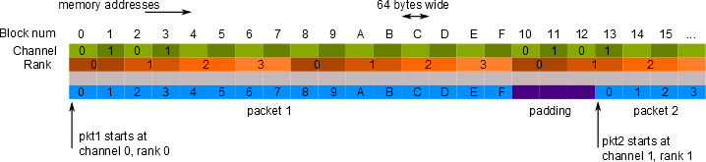
Intel Packet Processing Concepts
Intel® DPDK is designed for high-speed packet processing on IA. This is achieved by optimizing the software libraries to IA with some of the following concepts
Huge Pages Cache alignment Ptheads with Affinity
Prefetching New Instructions NUMA
Intel® DDIO Memory Interleave Memory Channel
Intel® Data Direct I/O Technology (Intel® DDIO)
Enabled by default in all Intel® Xeon® processor E5-based platforms
Enables PCIe adapters to route I/O traffic directly to L3 cache, reducing unnecessary trips to system memory, providing more than double the throughput of previous-generation servers, while further reducing power consumption and I/O latency.
Pthreads
On startup of the Intel DPDK specifies the cores to be used via the Pthread call with affinity to tie an application to a core. Reducing the kernel’s ability of moving the application to another local or remote core affecting performance.
The user may still use Ptheads or Fork calls after the Intel DPDK has started to allow threads to float or multiple thread to be tied to a single core.
NUMA
The Intel DPDK utilizes NUMA memory for allocation of resources to improve performance for processing and PCIe I/O local to a processor.
With out the NUMA set in a dual socket system memory is interleaved between the two sockets.
Huge Pages
The Intel DPDK utilizes 2M and 1G hugepages to reduce the case of TLB misses which can significantly affect a cores overall performance.
Cache Alignment
Better performance by aligning structures on 64 Byte cache lines.
Software Prefetching
needs to be issued “appropriately” ahead of time to be effective. Too early could cause eviction before use
Allows cache to be populated before data is accessed
Memory channel use
Memory pools add padding to objects to ensure even use of memory channels
Number of channels specified at application start up

Slide 7
PCIe* connectivity and core usage Using run-to-completion or pipeline software models
Look at more I/O on fewer cores with vectorization
Pool Caches
Queue/Rings
Buffers
Pool Caches
Queue/Rings
Buffers
NUMA
NUMA
QPI
Processor 0
Processor 1
Physical
Core 0
Linux* Control Plane
10 GbE
PCIe
Physical
Core 0
Intel® DPDK
Pkt
Rx
Tx
PMD Packet I/O
Hash
Pkt
10 GbE
PCIe
Physical
Core 1
Intel® DPDK
Pkt
Pkt
Physical
Core 1
Intel® DPDK
PMD Packet I/O
Packet work
Rx
Tx
10 GbE
PCIe
App A
App B
App C
Physical
Core 2
Intel® DPDK
Pkt
Pkt
Physical
Core 2
Intel® DPDK
PMD Packet I/O
Flow work
Rx
Tx
10 GbE
PCIe
PCIe
App A
App B
App C
Physical
Core 3
Intel® DPDK
Physical
Core 3
Intel® DPDK
PMD Packet I/O
Flow Classification
App A, B, C
Rx
Tx
Pkt
Pkt
Physical
Core 4
Intel® DPDK
Physical
Core 4
Intel® DPDK
PMD Packet I/O
Flow Classification
App A, B, C
Rx
Tx
10 GbE
RSS Mode
PCIe
Physical
Core 5
Intel® DPDK
Physical
Core 5
Intel® DPDK
PMD Packet I/O
Flow Classification
App A, B, C
Rx
Tx
Run to Completion model
I/O and Application workload can be handled on a single core
I/O can be scaled over multiple cores
Pipeline model
I/O application disperses packets to other cores
Application work performed on other cores
Notes:
Sample app how we would do it. But there are other ways to solve this. And there are other cases.

Slide 8
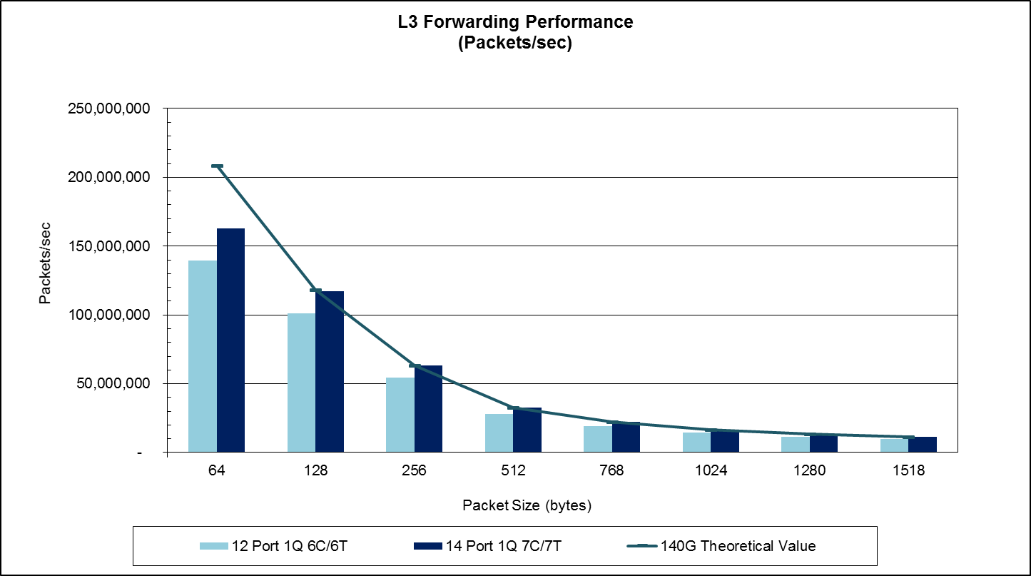
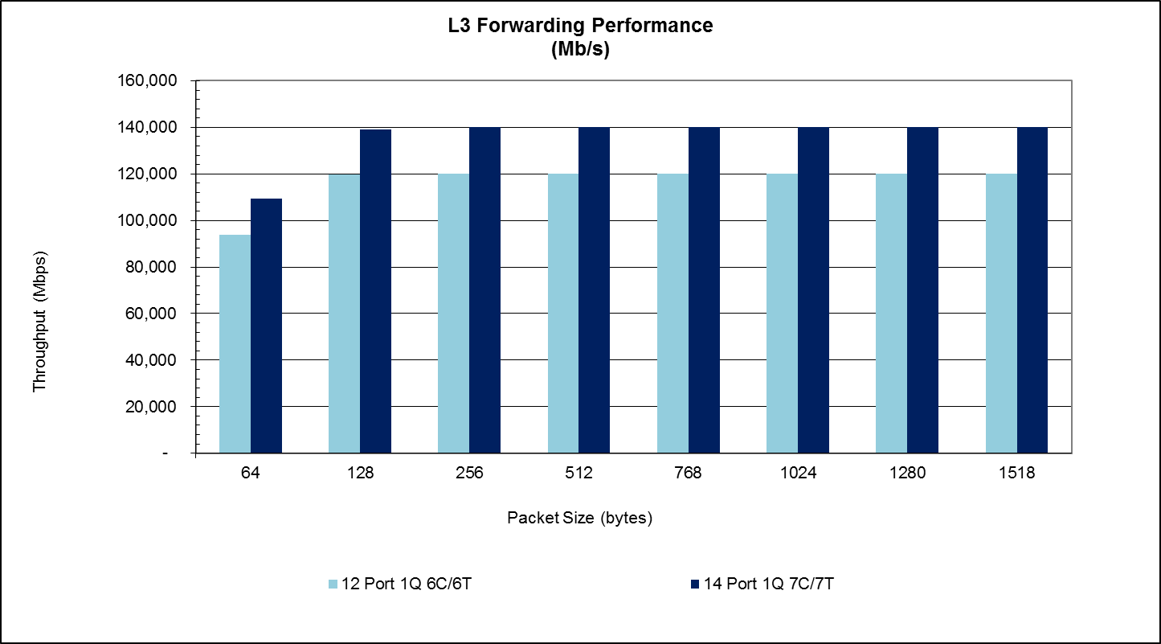
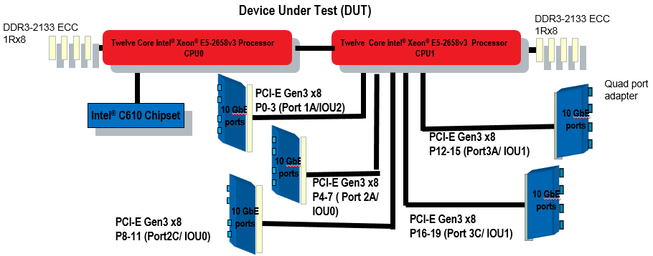
Performance: Intel® Xeon® Processor E5-2658v3
100% Line rate - 140Gbps
100% Line rate - 120Gbps
162.6 Mpps @ 64B packets
139.5 Mpps @ 64B packets
IPv4 L3 Forwarding for ONE 2.2GHz Intel® Xeon® E5-2658v3 processor with 14x 10GbE
Key Points:
162.6 Mpps @ 64B packets - 140Gbps line rate at @256B (99% at 128B)
64B packet throughput for 1 physical core (1C/2T) = 31.2 Mpps (E5-2658v2/DPDK1.6 = 28.5 Mpps)
64B packet throughput for 1 thread (1C/1T) = 28.8 Mpps (E5-2658v2/DPDK1.6 = 23.9Mpps)
DUT:
Intel® Xeon® E5-2658v3 processor , 2.20GHz, 30MB L3 cache
Dual (DP) Processors configuration. Only remote CPU is used due to better IO layout.
Intel® C610 Series Chipset
Wildcat pass platform (S2600WT)
DDR4 2133MHz, 1Rx4 8GB (total 64GB), 4 Channel per Socket
5 x Intel® X520-DA4 PCI-Express Gen3 x8 Quad Port 10 GbE Ethernet NIC (4x10G/card)
For more info see: l3fwd_DPDK_10G_S2600WT_C610_E5-2658v3_M1_DDR4-2133_MHz_ECC: http://cat.intel.com/LaunchLink.aspx?LinkID=3075
Date: September 23, 2014
Disclaimer: Software and workloads used in performance tests may have been optimized for performance only on Intel microprocessors. Performance tests, such as SYSmark and MobileMark, are measured using specific computer systems, components, software, operations and functions. Any change to any of those factors may cause the results to vary. You should consult other information and performance tests to assist you in fully evaluating your contemplated purchases, including the performance of that product when combined with other products. Source: Intel internal testing as of September 23, 2014. See Linux* Performance Tuning for configuration details. For more information go to http://www.intel.com/performance

Slide 9
DPDK Generational Performance Gains
IPV4 L3 Forwarding Performance for 64B
System Configuration (used for the Estimation)
Hardware
Platform | Wildcat Pass Beta
CPU | E5-2658 v3
Chipset | Wellsburg B0
Sockets | 2
Cores per Socket | 12 (24 threads)
LL CACHE | 30 MB
QPI/DMI | 9.6GT/s
PCIe | (4 Nics) Gen3x8 Socket 1 – 3 Nics socket 0
MEMORY | Micron DDR4 2133 MHz 1R ECC, 1DPC, 8GB/DIMM, 8DIMMs total
NIC | X520-4
NIC Mbps | 10,000
BIOS | SE5C610.86B.01.01.0519.050520140852
Software
OS | Ubuntu 12.04.4 LTS 64 bit
Kernel version | 3.2.553.2.0-23-generic
Other | DPDK1.7.0
 | All HW Prefetchers are enabled
Socket 0: 12x 10GbE using 6C (139.5 Mpps)
Socket 1: 14x 10GbE using 7C (162.6 Mpps)
Measured
Estimated
Disclaimer: Software and workloads used in performance tests may have been optimized for performance only on Intel microprocessors. Performance tests, such as SYSmark and MobileMark, are measured using specific computer systems, components, software, operations and functions. Any change to any of those factors may cause the results to vary. You should consult other information and performance tests to assist you in fully evaluating your contemplated purchases, including the performance of that product when combined with other products. E5-2658 (2.1GHz, 8C/16T) DP; PCH: Patsburg; LLC: 20MB; 16 x 10GbE Gen2 x8; 4 memory channels per socket @ 1600MT/s, 8 memory channels total; DPDK 1.3.0-154
E5-2658v2 (2.4GHz, 10C/20T) DP; PCH: Patsburg; LLC: 20MB; 22 x 10GbE Gen2 x8; 4 memory channels per socket @ 1867MT/s, 8 memory channels total; DPDK 1.4.0-22
*Projection data on 2 sockets extrapolated from 1S run on Wildcat Pass system with E5-2699 v3.
* Other names and brands may be claimed as the property of others.
Notes:
The new platform includes updated / expanded libraries and higher performance CPUs
Result? A 55% performance jump!! (55% = 255/164 – 1) …
<Optional anecdotes about value / utility of the platform approach, and customer responses to this cadence>
First we’ll talk about the HW components, and then the Data Plane Development Kit.
Socket 0 12x 10GbE using 6C, Socket 1 14x 10GbE using 7C,

Slide 10
Intel® DPDK Virtualization Architecture
Virtual Machine (VM)
Virtual Machine (VM)
NFV requires fast VM-to-VM communication:
R1.5
L2 Switching – Support Traffic Mirroring (Pool, VLAN, Uplink and Downlink) between VMs using Niantic
R1.6
Virtio PMD with Userspace vhost back-end
IVSHM support
Intel® DPDK
Intel® DPDK
e1000
VF
Virtio
ivshm
e1000
VF
Virtio
ivshm
Shared Memory (IVSHM)
3
1
Virtual Machine Monitor
(VMM)
Virtual Switch
2
vHost-net
Intel®
DPDK
user
PF
kernel
2
Intel® Architecture
VT-d
10 GbE 82599 (SRIOV)
3
VF
VF
PF
L2 Switch
1
Notes:
3rd case 1G IVSHM can be used between VMs and virtual switch but no protection, need to use 2M pages between each VM and virtual switch for protection which means there is a buffer copy

Slide 11
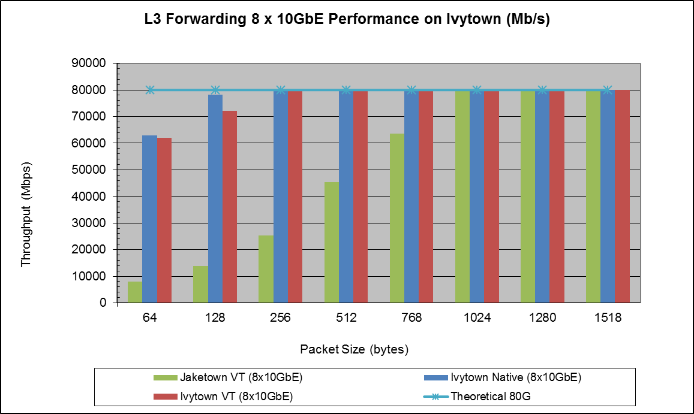
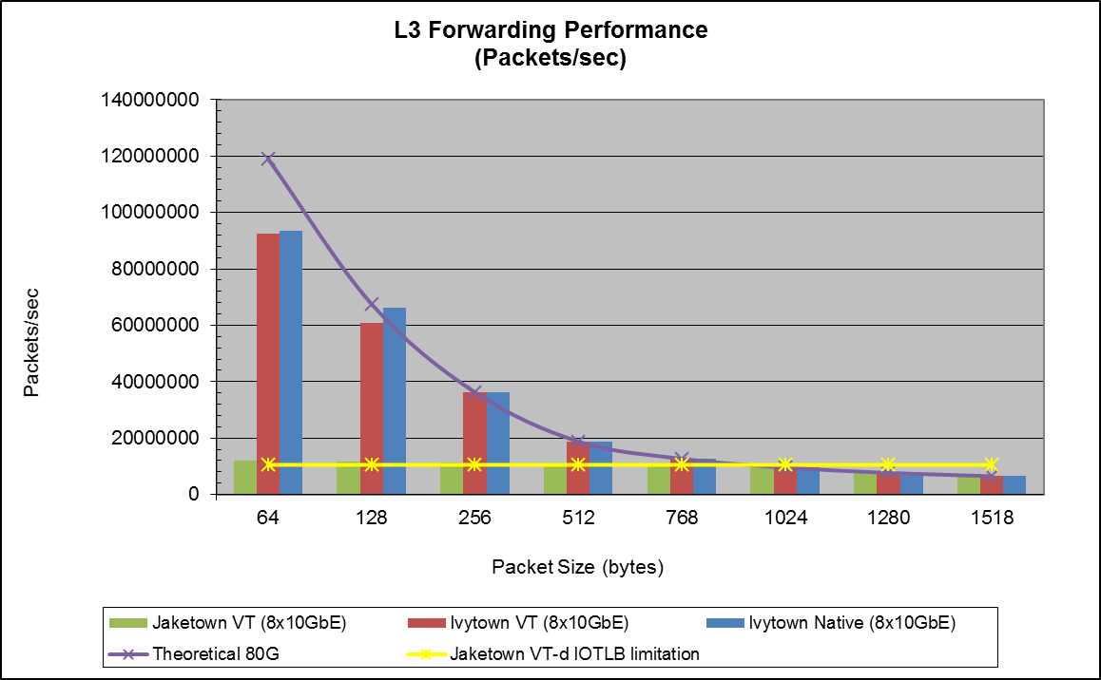
Outstanding VM Performance Improvements
Outstanding VT Performance
Small packet I/O rate to VM guests increases due to 1G IOTLB (only on Intel® Xeon®)
Increased virtualization performance: APIC Virtualization (e.g.. Eliminate the need for VMs to wait for thousands of instruction cycles per every exit to the VMM)
Great System Level Performance
Intel DPDK L3 forwarding in guest
Ivy Bridge-EP uses the VT-d IOTLB super page caching capability. Its performance with VT-d is close to native.
UP reaches full line rate (80 Gbps) beginning at 256B packet using 4 separate 82599 controllers (8 ports) and 8C/8T
Sandy Bridge-EP does not cache VT-d IOTLB super page, so the performance was limited to 11 Million packets per second.
Date: July 14, 2013
Disclaimer: Software and workloads used in performance tests may have been optimized for performance only on Intel microprocessors. Performance tests, such as SYSmark and MobileMark, are measured using specific computer systems, components, software, operations and functions. Any change to any of those factors may cause the results to vary. You should consult other information and performance tests to assist you in fully evaluating your contemplated purchases, including the performance of that product when combined with other products.
Source: Intel internal testing as of June 24, 2013. See Linux* Performance Tuning for configuration details.
For more information go to http://www.intel.com/performance

Slide 12
DPDK - 5 Qtr. Roadmap
Q4’14 (v 1.8) - PoR
Haswell Server
DPDK
DPDK Test Suite
Q3’15 (v 2.1) - Roadmap
Silicon Support
DPDK
Q4’15 (v 2.2) - Roadmap
Silicon Support
Broadwell server
DPDK
Fortville enhancements
mbuf updated
VM Power Manager
queue start/stop
Link Setting Support – Autoneg
RSS
Flow Director
VxLAN API
VMDq
Jumbo frames & Scatter Gather in virtio-pmd
Multicast packets in virtio-pmd & all VF PMDs
vhost-net for 2M pages
Make US-vHost backend a library
Link Bonding (mode 4 & 5)
Open Source Documentation conversion
Silicon Support
Cuckoo Hash with Thread Safety
Live migration bonded VM ports
Linux Containers (investigation)
Interrupt mode for PMD
CPU % utilization
AVX2 (memcpy, ACL)
X32 ABI
Single Virtio Driver
Fortville Features (Continued)
PCI Hot Plug Support
Integrated qemu user space vhost
Host interface for Red Rock Canyon
Fedora 21
Multiple pThreads per Core (cgroups)
Packet Distributor Phase 2
Packet Reordering
uio_pci_generic
RHEL 7.2 Integration
DPDK
Sageville (Intel® Ethernet Controller X550)
Red Rock Canyon (host interface only)
Broadwell DE
Silicon Support
Q1’15 (v 2.0) - Roadmap
Packet Framework (customer requests)
Performance Testing & Validation
Memory Management enhancements (customer requests)
Dynamic Link Libraries
Fortville Traffic management for Bandwidth distribution and limit
Socket Interface & Optimizations
Flow NIC
Platform QoS Integration
OPNFV Requirements
Cache QoS
Hybrid Switch (DPDK + RRC)
Lthread Library
OPNFV Investigation & Requirements
Bifurcated Driver
X550 Support
Note: Roadmap subject to change without prior notice
Shipping
In Development
Planning
Notes:
X550 support for Nov/Dec for BDW-DE early access customers.

Slide 13
Intel® Ethernet Controller XL710 (Fortville) Overview

Slide 14
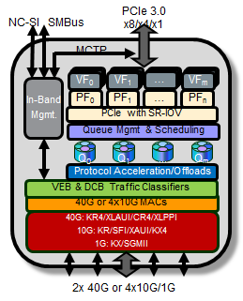
Fortville PMD Intel® XL710/X710 40-Gigabit Ethernet Controller
Feature | Benefit
Interfaces 2x40, 1x40, 4x10G, 2x10 KR4/XLAUI, KR/SFI/XAUI, KX4/KX/SGMII | Broad Offering of Physical Interfaces
Port Partitioning Multi-function PCIe 3.0 x8 16 Physical Functions, 128 Virtual Functions | Port partitioning technologies for heterogeneous traffic (LAN, SAN)
Standard’s Based Virtualization SR-IOV, EVB/802.1Qbg VEB (Virtual Ethernet Bridge) | Broad OS enablement
SDN and Network Overlays Flexible Filters (ATR, Flow Director) NVGRE, IPinGRE, VXLAN, MACinUDP | Abstract the network for cloud flexibility
Converged Networking LAN, SAN, Cloud Remote SAN boot with data path intelligent offload | Simplifying deployments by consolidating Reduce infrastructure and cabling costs Intelligent offloads optimized to accelerate software initiators
Management and Power Customer defined HW Personalities 10W device power | Exposes the right features to the right customer EEE, DMA and Interrupt coalescing
Description
Provides PCIe 3.0 x8: flexible choice for 10GbE and 40GbE
2x40, 1x40, 4x10G, 2x10
KR4/XLAUI, KR/SFI/XAUI, KX4/KX/SGMII, XLPP
Benefits
Multiple feature additions
Standard’s Based Virtualization (SR-IOV, Virtual Ethernet Bridging)
Port partitioning (16 PF, 128VFs)
SDN and Network Overlays (Flexible Filters, Cloud interfaces - VxLAN)
Lower Power
Use case
New i40e userspace Polling Mode Driver (supported in DPDK R1.7)
Provides access to Rx & Tx for applications
Used in DPDK sample applications
Recommended to always enable Extended Tag when the device/platform support it. See notes for more info
See High Performance of Small Packets on 40G NIC in notes
Notes:
High Performance of Small Packets on 40G NIC
Enabling Extended Tag and Setting Max Read Request Size
PCI configurations of extended_tag and max_read_requst_size have big impacts on performance of small packets on 40G NIC. Enabling extended_tag and setting max_read_requst_size to small size such as 128 bytes provide great helps to high performance of small packets.
These can be done in some BIOS implementations.
For other BIOS implementations, PCI configurations can be changed by using command of setpci, or special configurations in DPDK config file of common_linux.
Bits 7:5 at address of 0xA8 of each PCI device is used for setting the max_read_request_size, and bit 8 of 0xA8 of each PCI device is used for enabling/disabling the extended_tag. lspci and setpci can be used to read the values of 0xA8 and then write it back after being changed.
In config file of common_linux, below three configurations can be changed for the same purpose.
CONFIG_RTE_PCI_CONFIG
CONFIG_RTE_PCI_EXTENDED_TAG
CONFIG_RTE_PCI_MAX_READ_REQUEST_SIZE
Use 16 Bytes RX Descriptor Size
As i40e PMD supports both 16 and 32 bytes RX descriptor sizes, and 16 bytes size can provide helps to high performance of small packets. Configuration of CONFIG_RTE_LIBRTE_I40E_16BYTE_RX_DESC in config files can be changed to use 16 bytes size RX descriptors.
Traditionally, there are 5 bits for keeping track outstanding read requests, which means at any given time, there can only be 2^5 = 32 outstanding reads. PCIe Gen3 added Extended Tag support, which when enable allow 8 bits = 256 outstanding read request to be sent on the bus. This will help to hide the read to completion latency and is most effective at small packet size.
We did a comparison between extended tag enable and disable for 128B packet size, and the performance drop 26% without extended tag (on Fortville). Thus, it’s crucial to enable extended tag. If you’re testing larger packet sizes (i.e. >256B), you may not see performance difference with/without extended tag, because larger packet size has more room to tolerate latency.
It is recommended to always enable Extended Tag when the device/platform support it. There is no negative consequence with Extended Tag enable. If the device does not support Extended Tag, it will simply ignore the hint and use 5 bits for outstanding read requests.
Finally, latest DPDK has a configuration option to enable extended tag upon launching the DPDK application, so there is no BIOS dependency anymore. User can also manually enable the extended tag by doing the following command:
echo on > /sys/bus/pci/devices/0000:02:00.0/extended_tag #Replace 0000:02:00.0 with your FVL

Slide 15
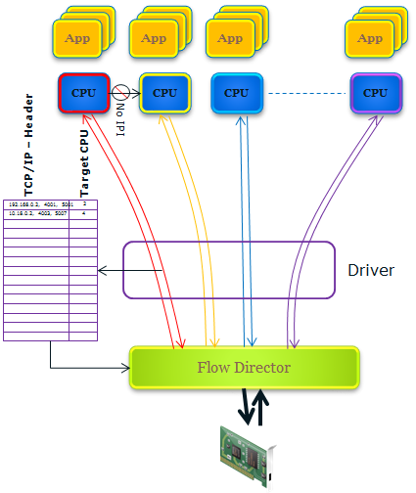
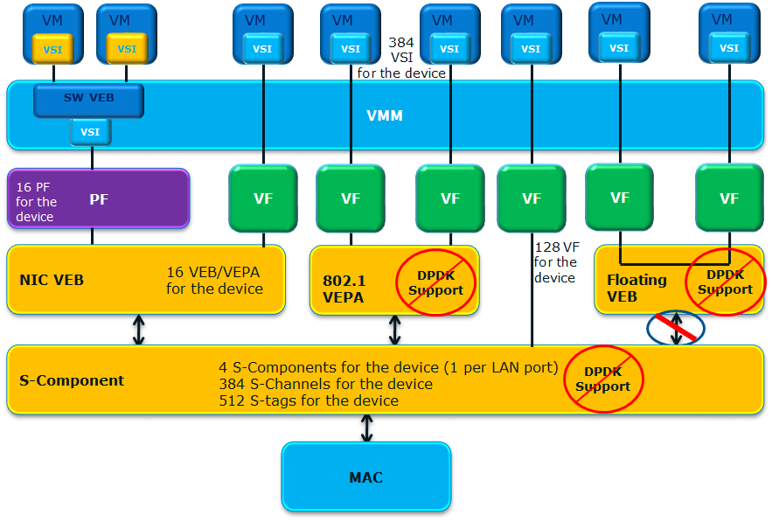
Fortville Enhancements Intel® XL710/X710 40-Gigabit Ethernet Controller
Fortville supports 8K perfect-match filters.
48 bytes from each received packet are checked for match
These bytes are selected from protocol header fields and payload
Byte selection depends on packet type
Protocol fields are preconfigured in NVRAM
SW can configure payload bytes selected per packet type
Actions on table match include:
Select destination queue
Drop packets
Copy SW-defined value to receive descriptor
Increment count in one of 512 packet counters
Description
Exposes additional features of Fortville
Provide support for the 16 internal VEB’s
allow VM to VM and physical port to VM packet movement.
Cloud VEB support for VXLAN Overlay API
Filters and Flow Director functionality
Benefits
VEBs - provide performance for VM – VM traffic movement
RSS – Indirection table per PF and VF
Advance Filters
Use case
Use of VEBs to provide VM – VM traffic
Multiple VF queues for different VMs with independent RSS
VXLAN stateless offloads (VXLAN Overlay API only)
Additional DPDK support coming in R1.8 – R2.1
Fortville Pathways
Notes:
There are 16 PF and 128 VF
RSS independent tables = 144 (128 for VF, 16 for PF)
RSS Queues there are up to 64 per PF and 16 per VF
Fortville’s 8K perfect-match filter table can be used in two ways:
Flow Director – higher-level software applies filters top-down
ATR – driver applies filters based on current traffic conditions
Fortville supports either ATR or Flow Director at a given time
Goal of ATR: Keep each flow on a single queue pair (CPU core)
Algorithm: Driver samples transmit traffic, adds receive filters to direct flows to the same queue pair
Use case for Flow Director
Flows are predictable, known in advance
Need advanced features like per-flow counters, flow drop, SW tag
Use case for ATR
Flows are constantly changing, unpredictable
Flow pinning is the only action required

Slide 16
Fortville Why? Niantic can provide a higher PPS rate for 64B packets - both hit line rate at 128B packets
Host Interface Functions
Filtering/Overlay Functions
Feature | Fortville | Niantic
PCI Physical Functions | Up to 16 in the device Up to 8 per LAN port | 2 per device 1 per LAN port
Number of queue pairs | 1536 queue pairs in the device | 128 queue pairs per function
Queue pair allocation per PF | Flexible via Non-Volatile memory | Fixed
Queue pair allocation per VF | Flexible from PFs allocation | Fixed
Number of VSIs | 384 VSI in the device | 64 VSI per LAN port
PCI Virtual functions | 128 VFs in the device | 64 VFs per LAN port
MSI-X Vectors | 1168 for the device (1K + 1/func) 512 for PFs and 512 for VFs | 64 per LAN port
Interrupt Moderation | 3 throttle rates per vector | 1 throttle rate per vector
VF Interrupt Cap | Yes | No
Feature | Fortville | Niantic
Receive Filters
RSS Queues | Up to 64 per PF and 16 per VF | Up to 16 per PF
RSS Indirection table | Independent table for each PF/VF | Single table for all functions on each port
Hashing Algorithms | Toeplitz Symmetric RSS XOR | Toeplitz
Flow Director | 8K filters Up to 64 different packet types (L2/IPV4/IPv6/TCP/UDP/SCTP) Drop or direct packets to queues 512 packet counters Filtering on flexible offsets | 8K per LAN port. TCP/IP or SCTP/IP only Drop or direct packets to queues
Overlay network support
Protocols | VXLAN (MAC-in-UDP), NVGRE (MAC-in-GRE), IP-in-GRE | No
Stateless Offloads | Checksum, TSO, VMDq, RSS | No
Packet Throughput is great but, packet recognition and handling in HW provides advantages!!
64 different packet types supported Better Filter/Flow Director support
Better Virtualization support (16 PF, 128 VF) Overlay Network Support
Virtual Ethernet Bridges
Notes:
While Niantic can provide a higher PPS rate for 64B packets both hit line rate at 128B packets.
Fortville offers better packet identification and processing capabilities

Slide 17
Fortville vs. Niantic (Virtualization)
Feature | Fortville | Niantic
PCI Virtual functions | 128 VFs in the device | 64 functions per LAN port
Number of VSIs | 384 VSIs in the device | 64 VSIs per LAN port
VMDq | Up to 256 VMDq1 and VMDq2 VSIs | Up to 64 VMDq1 and VMDd2 VSIs
Virtual Edge Bridge | 16 for the device Max 4 per physical function Floating VEB: VF to VF forwarding with no PHY link | 1 per physical function
802.1Qbg | One S-Comp per physical LAN port Multi channel S-Component Up to 384 Channels with 512 S-tags | No
Private VLAN | Yes | No
HW PF/VF communication | Yes | Yes
ACS | Yes | No
PCI SR Specification | 1.1 | 0.7
Broadcast Storm Protection | Yes | No
Ethertype Block | Yes | No
17

Slide 18
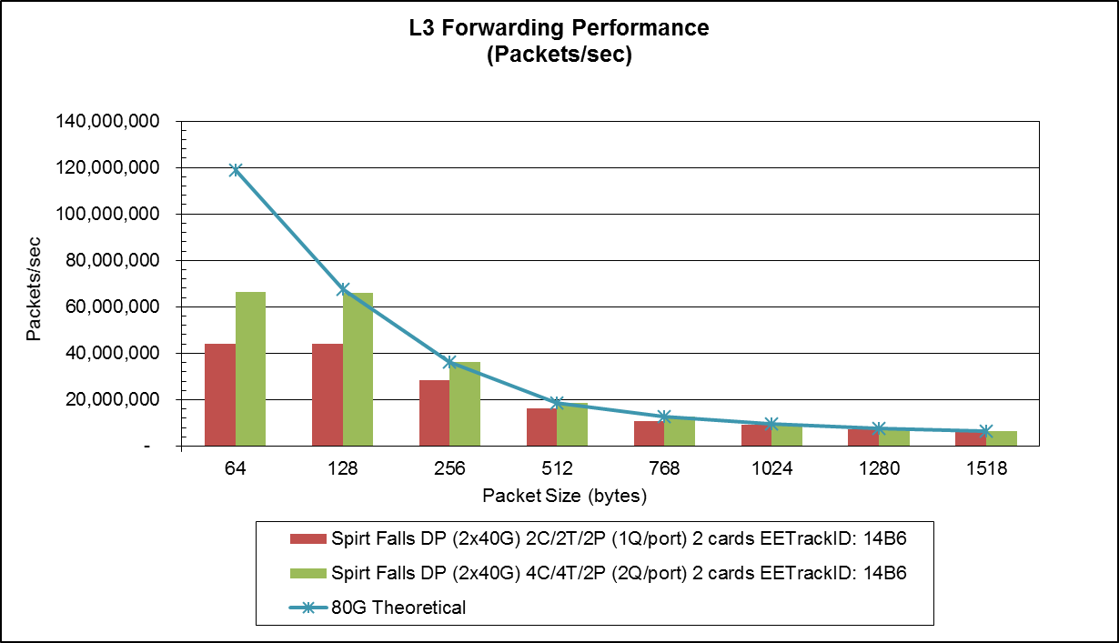
Fortville Performance
Intel® Xeon® Processor E5-2600v3 Family(1S) / Intel® XL710 Family / Intel® DPDK IPv4 L3 Forwarding using 10/40GbE Performance Intel XL710-QDA1/XL710-QDA2 2x40GbE on two cards
Notes:
The L3 forwarding tests were conducted using the Intel® Data Plane Development Kit (Intel® DPDK) L3 Forwarding example application. The performance could vary with a different stack.
Throughputs are reported in terms of IP Megabits/sec, accounting for each IP header bit and payload bit transported by the DUT. Throughput is defined by bits entering and leaving the system.
The data is collected with best known configuration with NUMA aware port allocation. Any non NUMA optimized configuration will result in performance degradation.
Using different Core, NIC, and/or Port arrangements than those shown may impact performance.
‘extended_tag’ should be enabled for high performance
Observations:
All cards can reach line rate @ 256 bytes payload and above.
10G interface (i.e. 2x10G & 4x10G) can reach line rate @ 128 bytes payload.
Maximum 64 bytes performance measured 36.9Mpps using 4x10G where Hardware limit is at 37.5Mpps.
Maximum larger packet throughput performance measured 49 Gigabits per second at 768 bytes payload using 2x40G where the card meets PCIe bandwidth limit.
Best performance with 2Q or 4Q per port
For more info see: DPDKv1.7.1_L3fwd_Fortville Performance_Report_v10: http://cat.intel.com/LaunchLink.aspx?LinkID=3074
Date: September 22, 2014
Disclaimer: Software and workloads used in performance tests may have been optimized for performance only on Intel microprocessors. Performance tests, such as SYSmark and MobileMark, are measured using specific computer systems, components, software, operations and functions. Any change to any of those factors may cause the results to vary. You should consult other information and performance tests to assist you in fully evaluating your contemplated purchases, including the performance of that product when combined with other products.
Source: Intel internal testing as of September 22, 2014. See Linux* Performance Tuning for configuration details.
For more information go to http://www.intel.com/performance

Slide 19
DPDK 1.7.1 Fortville Performance Summary (As of 10/01/2014)
Fortville
 | 2x10G DP | 2x10G QP | 4x10G QP | 2x40G 1 card | 2x40G 2 cards
NVM version | 4.26 | 4.26 | 4.26 | 4.2.4 | 4.2.6
EETrack ID | 14B4 | 1454 | 1454 | 12EF | 14B6
64B | 26.9Mpps#* (91% LR) | 26.9Mpps#* (91% LR) | 36.7Mpps* | 36.6Mpps* | 66Mpps/ (33Mpps per card)
128B (LR) | 100% | 100% | 100% | 39.6Gbps (50%) | 98%
256B (LR) | 100% | 100% | 100% | 47.8Gbps (60%)** | 100%
*#Limited by NVM currently.
Expect with NVM for FVL3 to get 99.9% ~Jan timeframe
*Limited by Hardware
**Limited by PCIe BW
HW Expectation:
64B:
10G line rate
20G line rate
40G 37.5Mpps
HW Expectation:
128B+:
10G line rate
20G line rate
40G line rate
HW Expectation:
2x40G single card:
Small Packet: 37.5Mpps
Large Packet: 40 – 50Gbps
DPDK is meeting HW expectation in most of the cases.
Date: September 22, 2014
Disclaimer: Software and workloads used in performance tests may have been optimized for performance only on Intel microprocessors. Performance tests, such as SYSmark and MobileMark, are measured using specific computer systems, components, software, operations and functions. Any change to any of those factors may cause the results to vary. You should consult other information and performance tests to assist you in fully evaluating your contemplated purchases, including the performance of that product when combined with other products.
Source: Intel internal testing as of September 22, 2014. See Linux* Performance Tuning for configuration details.
For more information go to http://www.intel.com/performance
Notes:
19
L3 forwarding

Slide 20
1.7 Features
Jun’14 (v 1.7) - Production
Silicon Support
Fortville Gen3 40GbE
DPDK
Fortville PMD for 4x10 & 40GbE
Packet Framework
Packet Distributor library
Link Bonding PMD Library
Move ACL and Vector PMD to BSD license
VFIO Driver
KVM Virtio improvements
zero copy mode RX/TX in user space vhost sample
multiple queues in virtio-net PMD
Support NIC filters in addition to flow director for Intel® 1GbE and 10GbE Controllers
IPv6 Fragmentation and Reassembly
Shipping
In Development
Planning

Slide 21
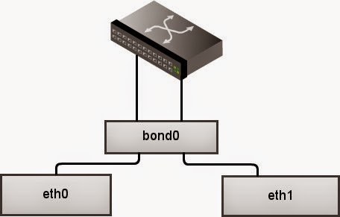
Link Bonding /Teaming Driver
Description
Aggregation of multiple (slave) NICs into a single logical interface
Benefits
Provides support for
redundant links,
fault tolerance
and/or load balancing of networks.
Use case
Supports bonding modes:
Mode 0 Balance Round-robin Policy (Default)
Mode 1 Active-backup Policy
Mode 2 Balance-XOR Policy
Mode 3 Broadcast Policy
Mode 4 IEEE 802.3 ad Dynamic Link Aggregation
Mode 5 Adaptive Transmit Load Balancing
Mode 6 Adaptive Load Balancing* (not in release)
DPDK R1.7
Required for future use case with bonding SR-IOV + Virtio for Live migration
DPDK R1.8
http://www.cyberciti.biz/howto/question/static/linux-ethernet-bonding-driver-howto.php

Slide 22
Packet Distributor Library
Description
Dynamic load balancing of traffic with processing on any available cores (first come first serve)
Packets flows must maintain order (no reordering)
Worker obtains next packet to process
Worker Thread/core
Benefits
Distributor core
Worker Thread/core
Packets in
Tags in use
Worker Thread/core
Suitable to Migrate Hardware based Legacy Applications
Sample Application coming in R 1.8
RSS distribution uneven, Distributer evenly balanced
Coalesce
Worker Thread/core
Worker Thread/core
Use case
Packet Distributor Vs Load Balancer – Where to Use?
Use Existing Load Balancer | Use New Packet Distributor
No Legacy Constraints. | Legacy Constraint.
Can optimize using burst transfer | Because of Legacy, cannot use burst
Performance is premium | Legacy code carrying over is must
Can do bursting | Packet Prioritization does not allow using burst

Slide 23
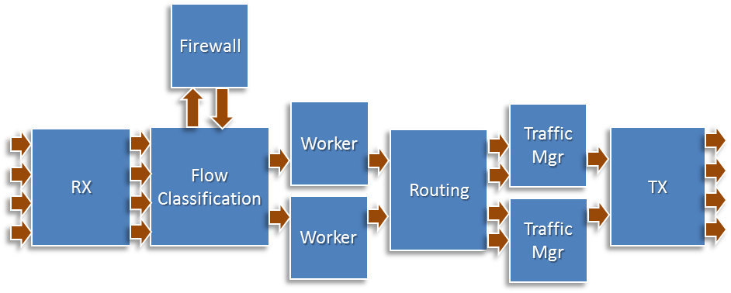
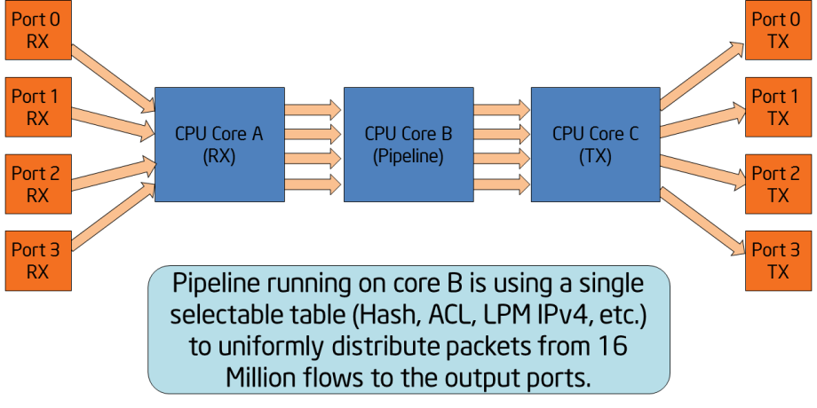
Packet Framework
Description
Command-based packet processing framework
Logically similar to SDN open flow
Benefits
1. IP Pipeline Sample Application
Faster Time To Market: Minimizes the development effort
Rapid Prototyping: Finding performance of realistic target appliance - Compared to simple l2fwd or l3fwd performance numbers
Use case
Capability to switch between pure s/w & h/w accelerated implementation
Two Sample Applications - Showcasing Functionality & Performance
IP Pipeline Sample Application shows how to create complex multi-core applications.
Test Pipeline Sample Application demonstrates the performance of single-table DPDK pipelines
Note: Thread Safety on roadmap with Cuckoo Hash (currently single table per pipeline)
2. Test Pipeline Sample Application

Slide 24
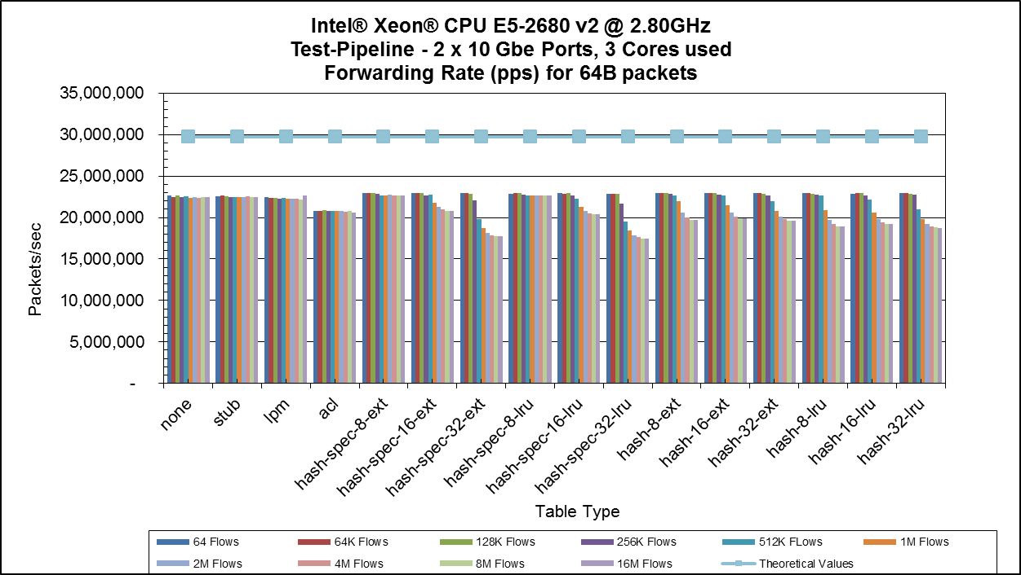
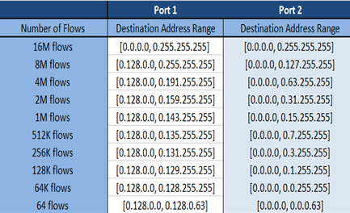
Packet Framework: Test Pipeline Sample Application Packet forwarding Throughput (2x10 Gbe ports)
The profile for input traffic is TCP/IPv4 packets with:
Destination IP addresses A.B.C.D are configure as:
A is fixed to 0 and B, C,D address are random
Source IP address fixed is set to 0.0.0.0
Source and Destination TCP ports are fixed to 0
One core is used for Rx, Worker, Tx functions each. For more info on above shown packet processing workloads see: DPDK Programmer’s Guide
NOTE: In the case of two ports, for LPM two routes are added to the table, For ACL two rules are added to the table (impact on more rules will be updated at a later date)
Good Throughput performance for up to 16M flows
Command : ./testpipeline -c 0xe –n 4 -- -p 0x5 --<Table Type>
Core 0, being the master core, is not specified in core-mask
Notes:
The hash tables are pre-populated with 16 million keys. For hash tables, the following parameters can be selected:
• Configurable key size implementation or fixed (specialized) key size implementation (e.g. hash-8-ext or hash-spec-8-ext). The key size specialized implementations are expected to provide better performance for 8- byte and 16-byte key sizes, while the key-size-non-specialized implementation is expected to provide better performance for larger key sizes;
• Key size (e.g. hash-spec-8-ext or hash-spec-16-ext). The available options are 8, 16 and 32 bytes;
• Table type (e.g. hash-spec-16-ext or hash-spec-16-lru). The available options are ext (extendible bucket) or lru (least recently used)
"hash with spec" is specialized implementation of hash algorithm that is optimized for a specific key size, e.g. 8 or 16 or 32 bytes
non-specialized hash is a hash implementation for which the key size is configurable
so LRU keeps the bucket length fixed to 4 keys, while EXT starts from 4 keys per bucket and can get bigger/smaller as keys are added /deleted from this bucket
If target a specific key size, e.g. 8 bytes, i can optimize my data structures much better and i can get fewer memory accesses per packet, i.e. better performance, i.e. 20 mpps instead of 16mpps
ACL has one rule per port.

Slide 25
1.8 Features
Q4’14 (v 1.8) - PoR
Silicon Support
Haswell Server
DPDK
DPDK Test Suite
Open Source Documentation conversion
mbuf updated
VM Power Manager
Jumbo frames & Scatter Gather in virtio-pmd
Multicast packets in virtio-pmd & all VF PMDs
vhost-net for 2M pages
Make US-vHost backend a library
Link Bonding (mode 4 & 5)
Fortville enhancements
queue start/stop
Link Setting Support – Autoneg
RSS
Flow Director
VxLAN API
VMDq
Performance Testing & Validation
Shipping
In Development
Planning

Slide 26
Test Suites Framework
DPDK Test Suites
Test Plans (rst)
Test Scripts
Configure Files
Description
Test Framework
Test Components
Configure Manager
Automation Test Tool for DPDK – a python-based library including one set of cases and framework
Improve quality of open source patch and leverage validation effort with developers
Exception Manager
TESTER
DUT
SSH Connection
Reporter
Test Case
CRB Management
Benefits
PacketGen
Linux Libraries & App
Open Source Developer can contribute code with functionality tests
Standardize DPDK software continue integration process and guarantee quality of patch
Simply DPDK environment configuration and save validation effort on different platforms.
Python
PktGen
TCL
SSH
SCP
GCC
Use case
Linux Kernel
Can run on remote tester machine connecting through SSH
Allows testing of DPDK under different OS’, Linux Kernels and GCC /ICC compilers
Measures both performance & functionality
Challenges to Validation on DPDK.ORG (Problems)
Need to acknowledge/test feature patch in timely manner.
Each features patch and example will have different behaviors in different environments, and cost a lot of issues and effort in platform configuration.
Have to verify different options with different of kinds Processors, NIC, Linux Kernel , Compiler. That’s huge & complicated matrix for testing.
Lack of automation test on open source community
Test Cases in DTS:
Command line Hello world
Multi process Timer
Blacklist /Whitelist Checksum offload
Jumbo frame Testpmd
L2fwd L3fwd
IP fragment Flow direction
Link flow control ieee1588
Packet Framework Vlan cases
NIC Generic Filter Link Bonding
Refer to Sample Application l3fwd_power_vm for API

Slide 27
Benefits from DPDK Test Suite - Standardize Continue Integration Process
Intel
DPDK Engineers
DPDK.org
Community
DPDK Test Suite provides a possibility to standardize our continue integration process and guarantee quality of patch.
Developer can submit their test code and test cases with their patch together.
Most of test cases and script can reused by DPDK.org, and enhance automation coverage.
Submit Code
DPDK.org
Dev Mail List
Automation
Build
Review Source Code
Ack & Test Package
Patch Test
Smoke Function
Feature Test
Apply Patch
OS & Compilation
Compatibility Test
Patch Rework
Continue Integration
Static Code
Coverage Test
Daily Regression Test
Send email
Unit Automation
Regression Test
DCTS
Regression Test
Publish Test result
in DPDK Org
CI Check List & Report

Slide 28
Benefits from DPDK Test Suite
Saving validation effort on new patch
DPDK Test Suite provides a solution to allow that DPDK developers contribute their function test to certify their patch integration. It only requires limitation effort to maintain test cases once merged into DPDK Test Suite. Everyone can utilize DPDK Test Suite to measure performance and functionality for features.
Easy to track and manage test result
After DTS finished the validation, all the result files will be saved in output folder. The files in output folder maybe different when change the CRB or choose different suites.
Generally output folder will contained these files:
CRB : folder contained with result RST file and graph of performance data
dts.log: Full execution log of DPDK Test Suite framework
statstics.txt: summary statistics of DPDK Test Suite executed suites
TestSuiteName .log: log message of suite
test_result.xls: excel format result file
Create suite plan for new feature
Manually dry run test case
Implement test suite in DTS
Verify new feature patch set by DTS
Fix gap between initial test plan
Example for Result:
[root@tester output]# cat statistics.txt
Passed = 2
Failed = 0
Blocked = 0
Pass rate = 100.0

Slide 29
VM Power Management
Description
CPU Frequency Scaling Manager (P- States) to use in NFV Environments
Problem: VMs have no ability to change host core frequency.
VMs see only virtual topology, Virtual to Physical cores may migrate
Solution: VMs issue hints & commands to a host monitor that governs power
Benefits
Ability to modify the frequency of cores used in VMs
Provides core mapping and low latency messaging to VM Power Manager
Use case
With Haswell+, more granular per core frequency scaling available
VM Power Manager may act on
Hints & commands from VM Power Agents
A CLI to alter VMs characteristics
A remote Orchestration Layer (if employed) accessing the VM Power Manager
Note prior power management work in an earlier release was based on a combination of CPU idling (C-States) using speculative sleeps and frequency hints to the HW-based frequency governor.

Slide 30
vhost-net for 2M pages
Description
Provides support for 2M pages with IVSHM
Allows each VM to have its own 2M page for communications with the virtual switch
VM0
VM1
Private 2M Page for packet movement
Private 2M Page for packet movement
Benefits
Protection for traffic flowing between VMs
OVS
OVS used for copying packet from one interface to another
VF
PF
Use case
VM to VM traffic using IVSHM with a virtual switch architecture
This requires a packet copy in the virtual switch to allow packet protection between VMs
If packet protection is not required a 1G page may be used to interconnect the virtual switch and all VMs thereby removing the packet copy

Slide 31
2.0 New Features
Q1’15 (v 2.0) - Roadmap
Silicon Support
Broadwell DE
Red Rock Canyon (host interface only)
Sageville (Intel® Ethernet Controller X550)
DPDK
RHEL 7.2 Integration
Bifurcated Driver
uio_pci_generic
Packet Reordering
Packet Distributor Phase 2
Multiple pThreads per Core (cgroups)
Fedora 21
Host interface for Red Rock Canyon
Integrated qemu user space vhost
PCI Hot Plug Support
Fortville Features (Continued)
Single Virtio Driver
X32 ABI
AVX2 (memcpy, ACL)
CPU % utilization
Interrupt mode for PMD
Shipping
In Development
Planning

Slide 32
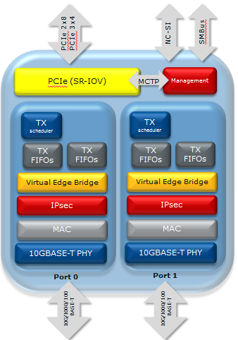

Sageville (Intel® X550) Support
Description
Support the Sageville 2x10GBASE-T Intel® Ethernet Controller X550-AT2 / X550-BT2.
Benefits
Optimized for Virtualization
128 Tx and Rx queues per port
RSS – Indirection table per PF and VF
Use case
Network Virtualization Stateless Offloads
NVGRE and VXLAN stateless offloads; Checksum, TSO, RSS, VMDq, header split
Packet Routing with Full wildcard support
Per Packet Timestamp - 1588
RX Queue
RX Filter
Inner DMAC, VLAN, Tenant ID
MAC
Outer DMAC as gate

Slide 33
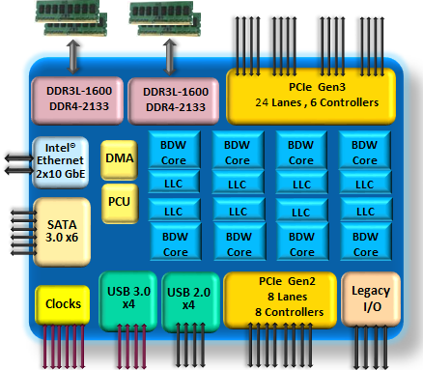
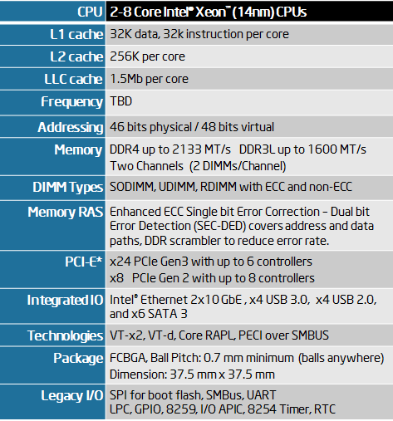
Broadwell-DE Support Intel® Xeon® processor D Family
Description
Support the Broadwell-DE SoC with New Microprocessor efficiency on the 14 nm Process
Integrated 10GbE controller (similar features to Fortville)
Benefits
Lower Power, Higher Physical Density with Large Memory Capacity (up to 128GB)
Supports new PREFETCHW instruction
Use case
Comms Mid-Range Solutions
Solutions for AMC, compact PCI & dense applications
Exceptional value, unmatched performance density
Data integrity, balance I/O and memory bandwidth
High Core count / Low Power Applications
Low Latency packet processing
Reduced power and real estate
DPDK Applications

Slide 34
RRC Support
Intel® Ethernet Switch (IES) API
IA
Application
Switch configuration and management of FlexPipe™ via IES API
Ethernet
4x25G
Packets handled via DPDK PMD
960Mpps
Ethernet 4x25G
Description
FlexPipe™
Frame Processing Pipeline
Ethernet
4x25G
Ethernet 4x25G
Proven switch architecture
Port Flexibility For Compute – Up to 36 25G/10G/2.5G/1G ports
Optimized for QoS and packet transfer
Ethernet 4x25G
Ethernet 4x25G
PCIe G3
1 x 8x
2 x 4x
Ethernet Cont
Rapid Array
Shared Memory
Ethernet 4x25G
Benefits
Ethernet Cont
Ethernet 4x25G
PCIe G3
1 x 8x
2 x 4x
High Bandwidth CPU Interface – 4 x 50 Gbps Ethernet controllers
Unparalleled hardware latency – 300 ns network latency when switching between external ports
Ethernet 4x25G
PCIe G3
1 x 8x
2 x 4x
Ethernet Cont
Internal Blocks
PCIe G3
1 x 8x
2 x 4x
Ethernet Cont
Management
Use case
PCIe 1x Gen3
Support the host interface for the Red Rock Canyon platform.
Support for host interface data path to DPDK PMD on IA
Setup of FlexPipe™ for Parsing, Configuration and actions currently via Intel® Ethernet Switch API
Additional DPDK features for RRC will be added in upcoming releases
Parser
Channels
CM
&
Sched
Modify
Header
L3+
Lookups
L3+
Actions
L2 Lookup
&
Filtering
Global
Ports
Egress
Action
128 byte deep
L2, L3, L4, *
Cascaded TCAM
32 1k Banks
16k Nexthop
16k MAC
4k VLANs
4k IP multicast
Statistics
FlexPipe™ Processing

Slide 35
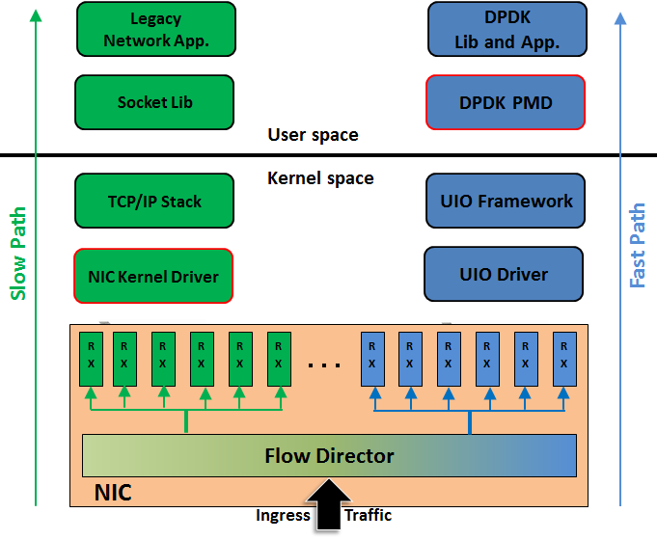
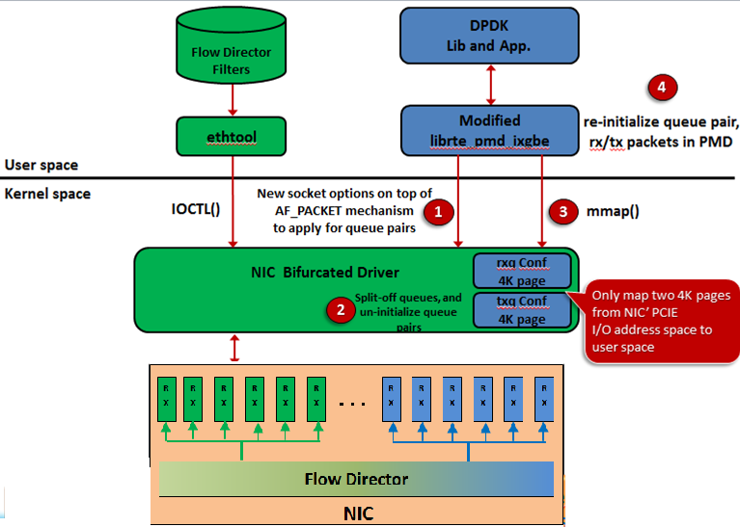
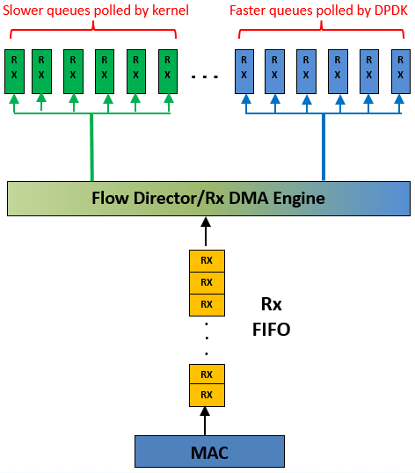
Bifurcated Driver
Description
Bifurcated kernel driver enables on-demand NIC resource (e.g. rx/tx pairs partition
Kernel will retain direct control of the NIC - assigns specific queue pairs to DPDK
Configuration of the NIC is controlled by the kernel via ethtool
Current Model
Benefits
Benefit of Linux tools configuring NIC and querying port stats
DPDK coexists with legacy socket based network applications
Reuse of DPDK performance optimization techniques (e.g. existing rx/tx routines, polling mode, huge page, fixed-sized packet buf)
Use of Huge page support in DPDK
Use case
Bifurcated Driver PMD in DPDK depends on kernel code
NIC Rx/Tx Queue Descriptors requested by DPDK can access DPDK protected memory region only
AF_PACKET directly map certain 4K pages on NIC's I/O space to user space, bypass UIO and VFIO. Per socket options request passed from DPDK to AF_PACKET
corresponding DPDK PMD patches will be submitted to community
Bifurcated Model
Head of Line Blocking
Rx FIFO “head of line blocking” in bifurcated configurations
can only move as fast as the quickest queues
Solution: Enable SRRCTL.DROP_EN drops packets from Rx FIFO
Notes:
Note currently does not provide support for 1G igb devices since no flow director. Currently under investigation
Also does not support virtio or vmxnet3 since they only have a single queue pair in the kernel

Slide 36
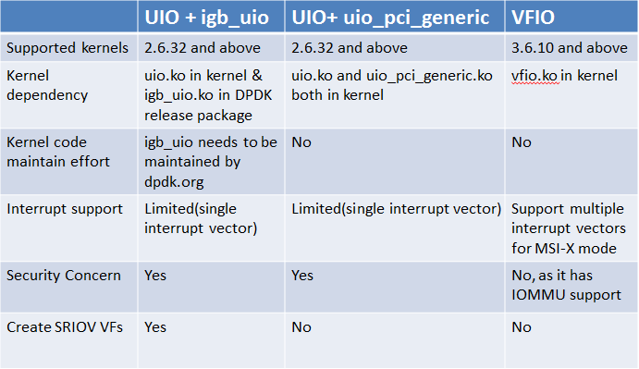
UIO_PCI_Generic kernel module support
DPDK App
Description
Port0
Port1
Leverage uio_pci_generic in-kernel module to support DPDK user space PMD in a generic fashion
Provides a alternative UIO approach to support user space NIC driver, instead of using igb_uio
userspace
Kernel
Uio_pci_generic
UIO
Benefits
igb
ixgbe
Remove DPDK dependency on the tiny kernel driver igb_uio which is not an upstremable kernel module
Enable OSV to package GPL-free DPDK code in old kernels (<3.6.0) without VFIO support
i40e
Use case
Enable DPDK to run purely in user space without depending on none-upstreamable kernel module igb_uio
modprobe uio
modprobe uio_pci_generic
DPDK can run purely in user space on other architectures without IOMMU that VFIO depends on
Notes:
Linux kernel provides UIO as well as VFIO mechanism to support writing user space device driver. Comparing to UIO which is available since 2.6.32 kernel, the VFIO is introduced into kernel since version 3.6.0 with better interrupt and memory protection (build on top of Intel VT-d technology) supports.
Basically, UIO and VFIO do two common things below:
1) Map PCIe device's I/O memory space to user space driver
2) Support device interrupt notification mechanism allows user space
driver/application is notified when device interrupt triggers.
To run an DPDK application and make use of VFIO, two in_kernel modules vfio and vfio-pci module must be loaded. But to use UIO, a DPDK kernel module igb_uio, which was there since DPDK is invented, must be loaded to attach to in_kernel uio module. As an possible solution to deprecate igb_uio, this RFC patch leverages uio_pci_generic this in_kernel module to support DPDK user space PMD in a generic fashion (like how VFIO works today), to partially (DPDK KNI module rte_kni still sits in kernel) remove DPDK dependency on GPL code igb_uio in kernel. Tests with uio_pci_generic shows performance remains same and LSC interrupts works as before.
Example to bind Network Ports to uio_pci_generic:
modprobe uio
modprobe uio_pci_generic
/* to bind device 08:00.0, to the uio_pci_generic driver */
./tools/dpdk_nic_bind.py -b uio_pci_generic 08:00.0
Note: this RFC patch does not completely remove igb_uio support due to igb_uio supports creating maximum number of SR-IOV VFs (Virtual Functions) by using max_vfs kernel parameter on older kernels (kernel 3.7.x and below).
Specifically, igb_uio explicitly calls pci_enable_sriov() to create VFs, while it is not invoked in either uio or uio_pci_generic. On kernel 3.8.x and above, user can use the standard sysfs to enable VFs. For examples:
#echo $num_vf_enabled > /sys/class/net/$dev/device/sriov_numvfs //enable VFs
#echo 0 > /sys/class/net/$dev/device/sriov_numvfs //disable VFs

Slide 37
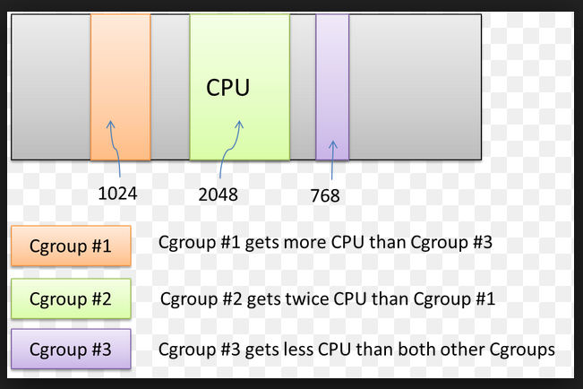
Multiple pThreads per Core (cgroups) Core Oversubscription
Floating pThreads
Assigned
pThreads
Assigned
pThreads
Assigned
pThread
pThread
pThread
30%
Description
pThread
20%
pThread
pThread
pThread
10%
40%
Allow multiple DPDK pThreads to be assigned to a logical core or float, to better use resources.
Use cgroups (control groups) to control the resources (e.g. Pre-emptive multitasking )
pThread
40%
pThread
60%
pThread
100%
Linux
CPU
Core 0
CPU
Core 1
CPU
Core 2
CPU
Core 3
Benefits
Many operations don’t require 100% of a CPU so share it smartly
Utilize CPU resources more efficiently instead of 1 pThread per logical core
Better control of application performance, lower or higher performance when needed
Cgroups allows Prioritization where groups may get different shares of CPU resources
Figure 1: pThread affinity model
Use case
Assign DPDK pThreads to float for infrequent tasks such as management applications
Assign multiple pThreads to an lcore and determine the utilization each requires. Utilization may change over the period of time and so may the pThreads requirements of the core.
Figure 2: cgroup – Pre-emptive multitasking
http://eecatalog.com/embeddedlinux/2012/06/28/improve-linux-real-time-performance-in-multicore-devices-with-light-weight-threading/

Slide 38
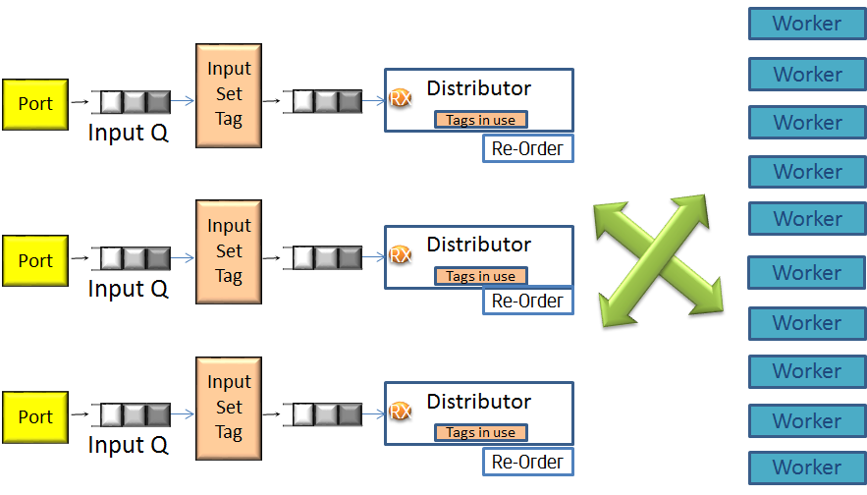
Packet Distributor Enhancements
Description
Dynamic load balancing of traffic with processing on any available cores (first come first serve)
Packet tagging and reordering
Benefits
Packet reordering allows better use of worker threads when packets in flows are allowed to be processed in parallel
allow parallelization of distributers
Use case
Legacy customer Solutions converting to DPDK
Better scaling for some packet processing over RSS/Hashes

Slide 39
Integrated Qemu User space vHost
Description
Previously the DPDK create a userspace vhost model for VM communications with the older QEMU
As of QEMU 2.1 a new "vhost-user" backend for -net and -netdev is provided which allows the DPDK to adopt the new QEMU approach
Benefits
Adoption of the new QEMU 2.1 approach simplifies the DPDK’s approach to the integrated vHost environment.
DPDK user community will be able to leverage the innovations happening in vHost environments, which are driven by the respective open source community.
Use case
Mechanism for host to VM communication
Host virtual device communication to VMs VirtIO

Slide 40
PCI Hot Plug Support Live Migration support
VM
VM
Description
SR-IOV
IF
Virtio IF
SR-IOV
IF
Virtio IF
OVS
OVS
Live Migration of an SR-IOV interface requires the ability for a new bus address (BDF) to be discovered (PCI Hot plug support) on the new server. Bonding of an SR-IOV interface and a Virtio interface should provide the ability for the VM to be migrated
VF
PF
VF
PF
Benefits
Server 1
Active – Passive bonded ports. SR-IOV is active
Server 2
After migration unbounded ports. System re-establishes tries to re-establishing bond. Initially virtio is active. Then SR-IOV port is enabled and takes on active roll.
First requirement for Live Migration of VMs having SR-IOV
Allows SR-IOV ports to be added on the secondary server
Use case
Four steps –
the bonded device is used,
pre-migration the SRIOV device is unplugged and time passes to allow any buffers from it to flush out from the system, and the virtio interface is used instead
the VM is migrated,
the new SRIOV device is added and then merged into the bonded device.
To initialize the post-migrated VF on the new hardware

Slide 41
X32 ABI support
Description
Supports x32 ABI - Application binary project and one of the interfaces of the Linux kernel
x32 ABI was merged into the Linux kernel for the 3.4 release with support being added to the GNU C Library in version 2.16. (Linux Kernel 3.4 is compiled with CONFIG_X86_X32=y)
Benefits
Programs gain the advantage of x86-64 while using 32-bit pointers, avoiding the overhead of 64-bit pointers.
larger number of CPU registers, better floating-point performance, faster position-independent code shared libraries, function parameters passed via registers, faster syscall instruction
Use case
Provides more registers but in 4GB of address space
Better use of cache lines due to 32b pointers, reducing misses
Systems where you can build everything in x32 mode

Slide 42
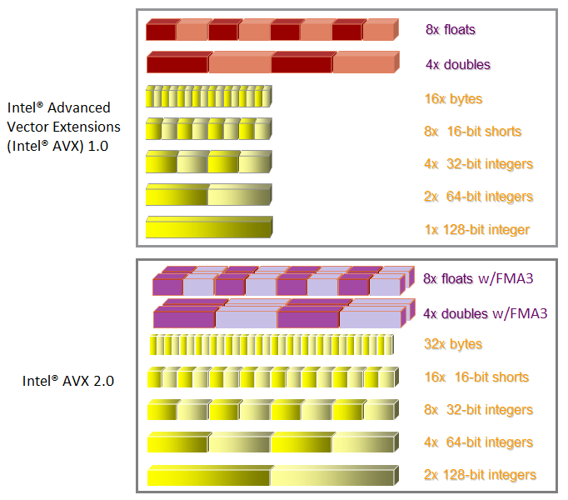
AVX2
Description
AVX2 – SIMD instruction support for 256-bit integer vectors
Extends 128-bit integer vectors instructions to 256-bit
Use the same 256-bit YMM registers as Intel AVX
Support available in Haswell and with GCC 4.7
Benefits
Performance enhancements
Useful for ACL look up and memory copy
Use case
Available on Haswell
Wherever there is Data Parallelism
Bulk Processing and Table Lookup
http://www.intel.com/software/avx
https://embedded.communities.intel.com/community/en/applications/blog/2013/08/15/intel-advanced-vector-extensions-avx-20-offers-breakthrough-performance-for-medical-imaging

Slide 43
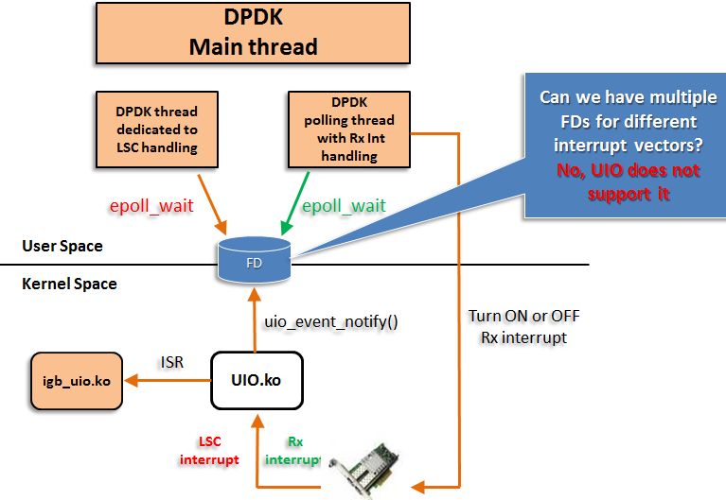
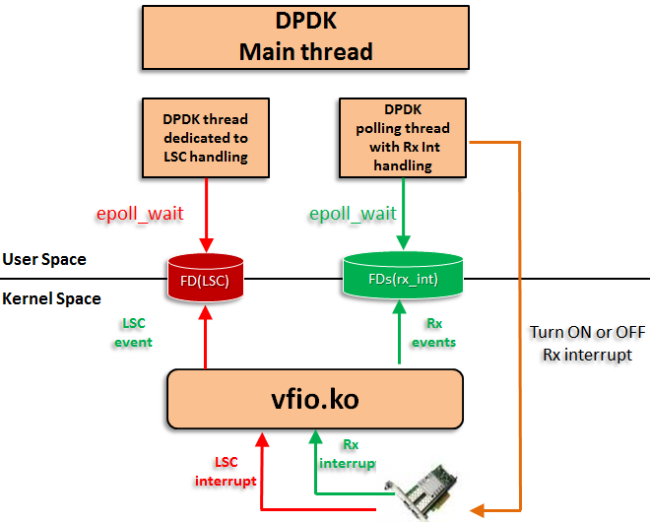
Interrupt Mode Support
Description
Intelligent transition between polling mode and interrupt mode depending on actual packet load
Essentially operate a “NAPI” type loop in user space
Benefits
Possible UIO Mechanism
Possible VFIO Mechanism
LSC interrupt and Rx interrupt handled by different DPDK threads respectively
Power saving and CPU resource sharing
Build up on VFIO mechanism supporting up to 64 MSIx interrupt vectors that can be used to support per-queue mode transition
Use case
Saving of power and CPU cycles is more important
Increased latency / jitter is acceptable in this model
Polling thread yield when traffic is low to let other threads to run
Interrupt modes for Link Status Change (LSC) and Rx events

Slide 44
2.1 New Features
Q3’15 (v 2.1) - Roadmap
Silicon Support
DPDK
Cuckoo Hash with Thread Safety
Lthread Library
OPNFV Investigation & Requirements
Live migration bonded VM ports
Linux Containers (investigation)
Flow NIC
Packet Framework (customer requests)
Memory Management enhancements (customer requests)
Dynamic Link Libraries
Fortville Traffic management for Bandwidth distribution and limit
Socket Interface & Optimizations
Platform QoS Integration
Cache QoS
Shipping
In Development
Planning

Slide 45
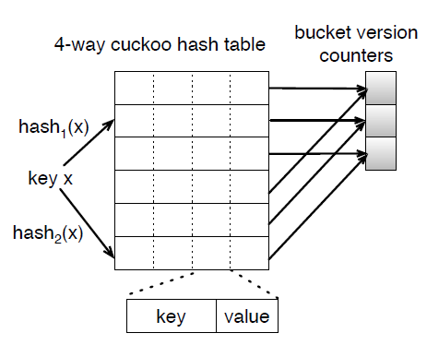
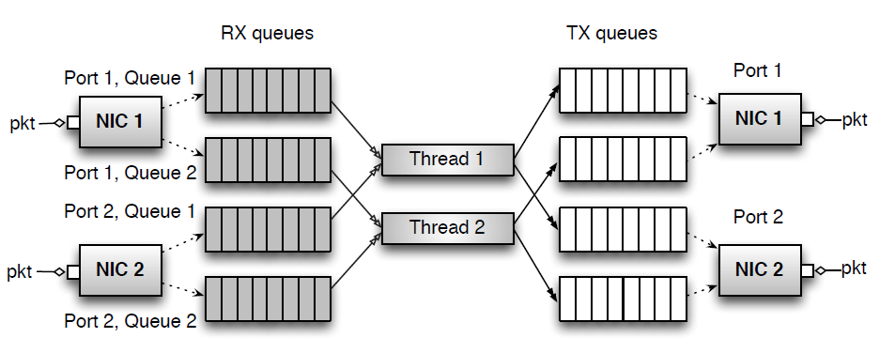
Cuckoo Hash w Thread Safety
Description
New hash algorithm implemented as part of the Cuckoo Switch project
Built around a memory-efficient, high-performance & highly-concurrent hash table
Benefits
Compact and fast FIB lookup
90 Million Mpps with forwarding table of 1 billion forwarding entries
Improve performance by using single hash table used by multiple threads/processes
A 2,4 Cuckoo hash table
Use case
Any packet processing application which comprise of multiple threads accessing common table.
Complex packet processing pipelines implemented with packet Framework
SDN and CCN (Content Centric Networking)
Require extremely large, fast forwarding tables
With 40 Gbps links
Not just more lookups / sec, but into increasingly large tables
Packet Processing Pipeline of Cuckoo Switch
http://www.cs.cmu.edu/~dongz/papers/cuckooswitch.pdf

Slide 46
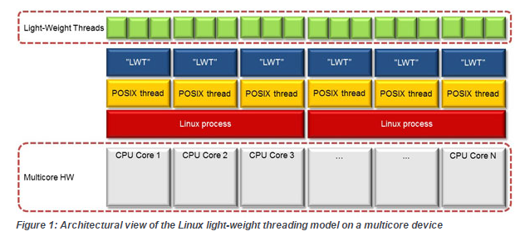
Lthread Library Core Oversubscription
Description
Pre-emptive multitasking - cgroups (control groups)
Task switch still happens inside kernel
Co-operative multitasking - Lightweight thread library
Task switch depends on proactive yield.
Benefits
Performance boost is made of 4 parts
DPDK raw socket
Lighter task switch on lthreads
Locks not needed in cooperative environment
Have DPDK workers use lthread sleep rather than poll rdtsc
Use case
Useful when a DPDK thread does not require a full resources of a core
http://eecatalog.com/embeddedlinux/2012/06/28/improve-linux-real-time-performance-in-multicore-devices-with-light-weight-threading/

Slide 47
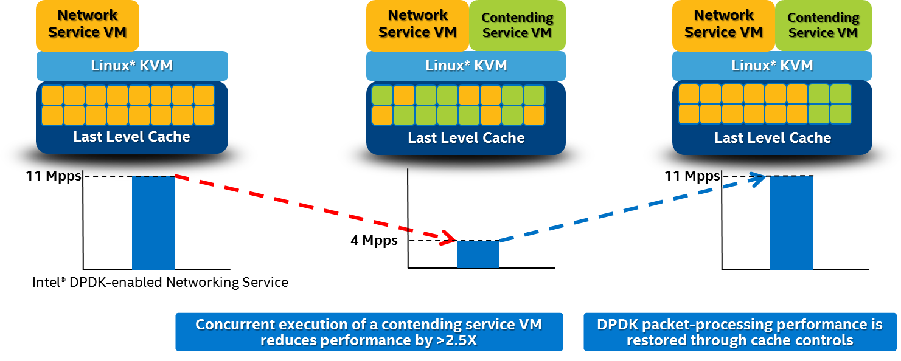
Cache QoS
Description
Haswell+ Servers introduces DDIO way control, Cache allocation, Cache monitoring
Cache Allocation configures the amount of resource available to a particular class of service
Cache Monitoring monitors LLC* cache occupancy on a per s/w ID basis
Benefits
Reduces cache pollution by “noisy neighboring VMs”
Use case
Concurrent execution of contending service VMs
Refer Doc# 553523 titled “Server Communications and Storage Infrastructure Platform QoS Implementation Guide”

Slide 48
Linux Containers (Investigation)
Linux Containers
Description
Shared Mem
Containers combine cgroups and namespace support to provide an isolated environment for applications
Kernel
Benefits
Host
Potential for faster startup, lower latency and fast communications between applications in different containers
Use case
Customers asking about use cases such as NFV environments vs. the traditional virtualization model
Explore customer interests
Containers can communication via protected shared memory and/or NIC bridging.
Open vSwitch can be run in the host and packets transferred via shared memory
Containers could run VMs

Slide 49
2.2 New Features
Q4’15 (v 2.2) - Roadmap
Silicon Support
Broadwell server
DPDK
OPNFV Requirements
Hybrid Switch (DPDK + RRC)
Shipping
In Development
Planning

Slide 50
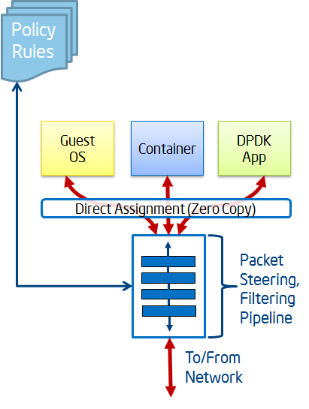
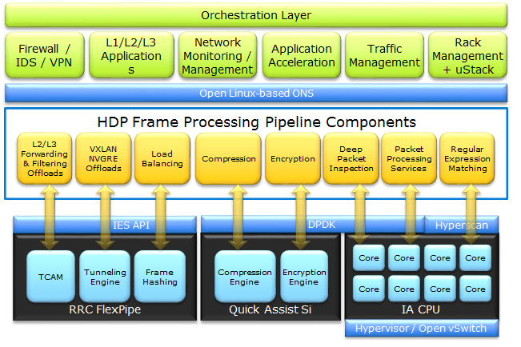
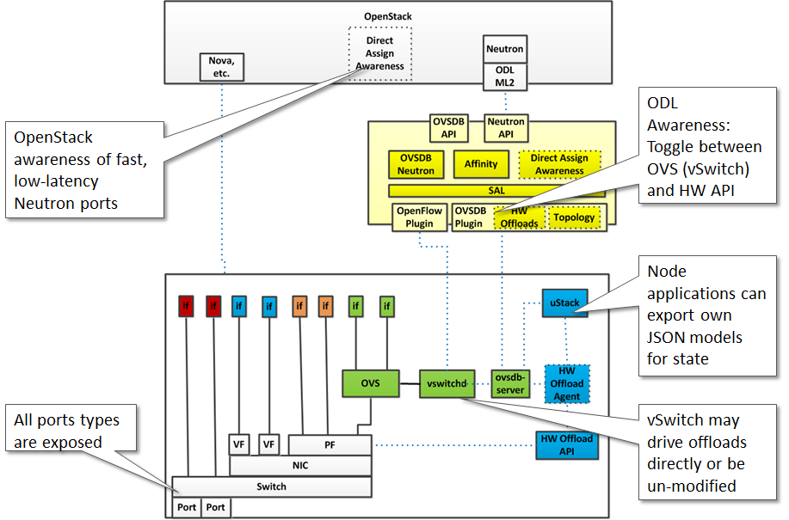
HW Offload
Description
IA-based packet processing abstraction implemented in software, hardware or both
Offloads API provides interface to load policy into the hardware
Works with vSwitches & SDN controllers
Open Source, Supports NNT, FVL, RRC, could also support non-Intel
Benefits
Offload Policy
HW Components involved
Abstract underlying hardware using DPDK software (CPU, controller, accelerator, switch, etc.)
Direct Assignment Under Policy Control
Zero-Copy of packets into: Guest OSes (SR-IOV), Containers, Applications
Eliminates Network Virtualization ‘Cost’
Preserves Existing Control: Security, observability, and programmability of today’s vSwitches accelerated on the server platform
Use case
Enable a Best in Class IA dataplane for SDN and NFV
Based on an IA server platform with Intel DPDK/PF and making optimal use of Intel silicon ingredients (e.g. FVL, RRC as a NIC, etc)
Table Creation (RRC)
Ability to ‘splice’ an existing TCAM table to create smaller, more focused tables for better packing
Intel Silicon for HW Acceleration
Pre-classify: Extract metadata to speed up IA CPU processing
Balance: Load spread traffic across CPU sockets, cores, queues & threads
Overlays: Stateless offloads in the presence of overlays and/or full endpoint
Match Action: Pre-process frames with hardware (ACLs, steering, FD, etc.)
Post Modify: QoS, traffic management, packet replication, mirroring, timestamps
Integration Points: OVS, ODL, OpenStack

Slide 51
Backup

Slide 52
VFIO kernel module support
DPDK App
Description
Port0
Port1
Ports used by DPDK must be bound to the igb_uio or vfio-pci module before the application is run.
Provides alternative to igb_uio driver, VFIO available in kernels since 3.6.0
igb_uio is not an up streamed kernel module
userspace
Kernel
vfio-pci
igb_uio
Benefits
igb
ixgbe
Some Limitations now (see Notes) - but VFIO has a future over UIO
Part of the latest kernels
i40e
Use case
kernel and BIOS must support and be configured to use IO virtualization (Intel® VT-d)
To enable Intel® VT-d in a Linux kernel, a number of kernel configuration options must be set:
IOMMU_SUPPORT
IOMMU_API
INTEL_IOMMU
iommu=pt is compulsory for igb_uio driver, the vfio-pci driver can work with both iommu=pt and iommu=on.
iommu=pt results in pass-through of the DMAR (DMA Remapping) lookup in the host.
if INTEL_IOMMU_DEFAULT_ON is not set in the kernel, the intel_iommu=on kernel parameter must be used too. This ensures that the Intel IOMMU is being initialized as expected.
Notes:
The EAL uses the /sys/bus/pci utilities provided by the kernel to scan the content on the PCI bus.
To access PCI memory, a kernel module called igb_uio provides a /dev/uioX device file that can be mmap'd to obtain access to PCI address space from the application. It uses the uio kernel feature (userland driver).
“physical functions require all ports on a given NIC” be bound to vfio. There are perhaps other limitations of vfio that may need to be mentioned – doesn’t work on Rangeley, doesn’t work inside a VM, has a performance penalty on sandy bridge, cannot create VF devices while PF is bound to VFIO so cannot use DPDK on host and guest simultaneously, etc. etc.

